Slide 1


Slide 2

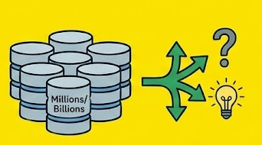
What’s data warehouse
It’s a system optimized for analytics, not for transactions. Instead of handling single records like OLTP databases, a data warehouse handles huge scans, aggregations, and complex queries across millions/billions of rows.

Slide 3
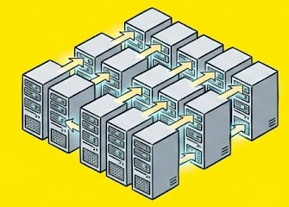
What’s Redshift
Redshift is AWS’s fully managed data warehouse optimized for massive parallel processing (MPP) and distributed columnar storage.

Slide 4


Key Characteristic
Columnar tables are a core characteristic of Redshift and modern data warehouses because they allow fast scans, high compression, and efficient analytical queries.
row oriented
SELECT name, os, why_os FROM people;
column oriented

Slide 5
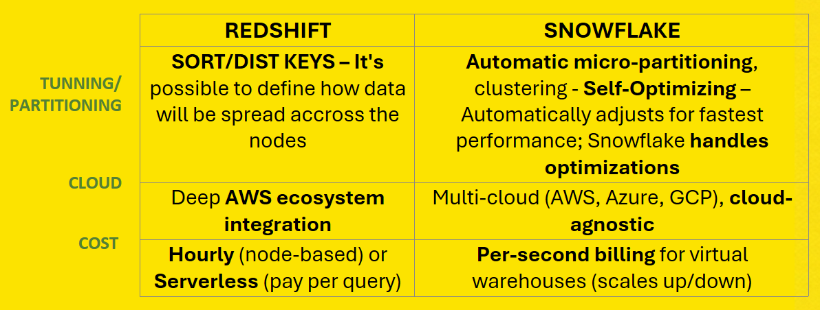

Comparison

Slide 6
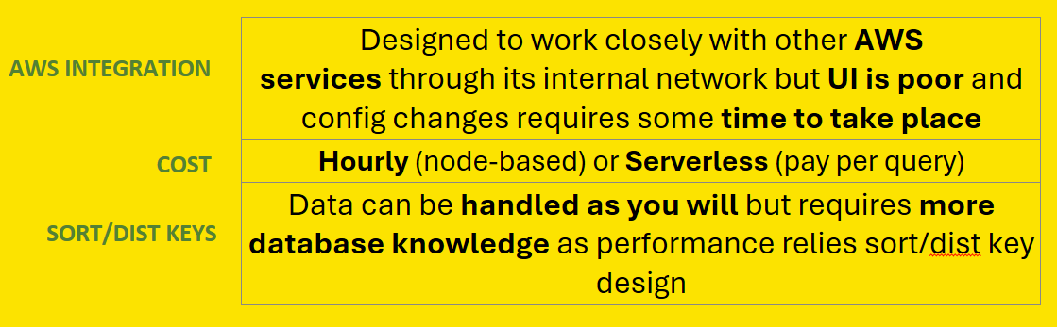

Trade-offs

Slide 7
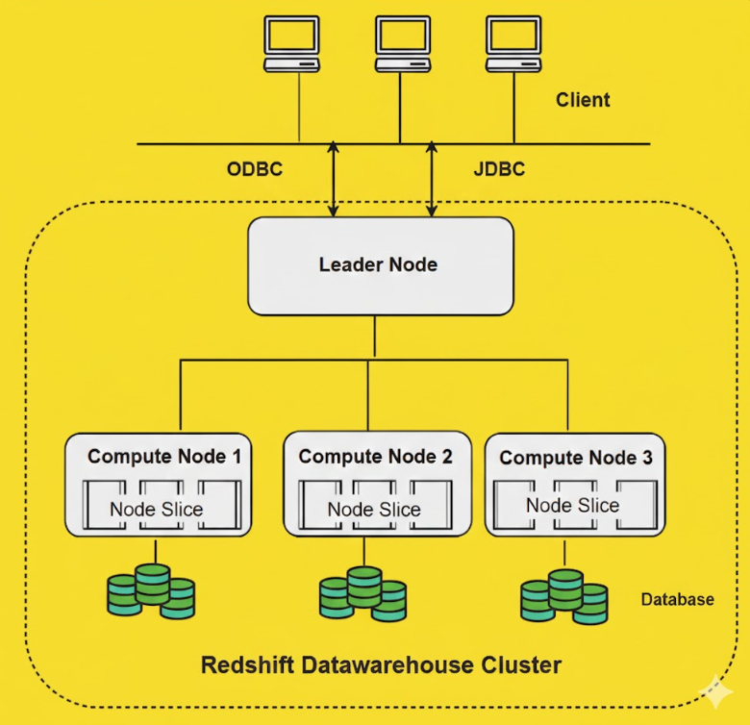
Architecture

Slide 8
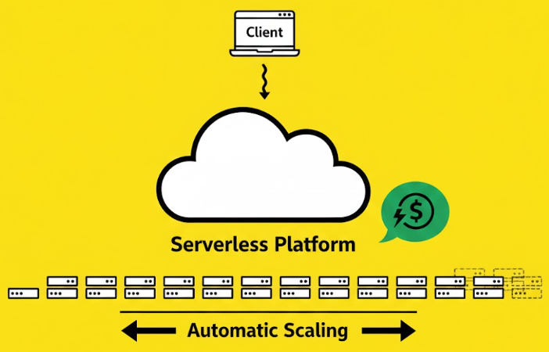
Serverless
Based on RPUs
1 RPU = 16 GB of memory
Billed per second for the RPU-hours consumed during active workloads, with a minimum charge of 60 seconds per query.
Up to 1024 RPUs
Autoscaling works with performance set to “Price-performance target”

Slide 9
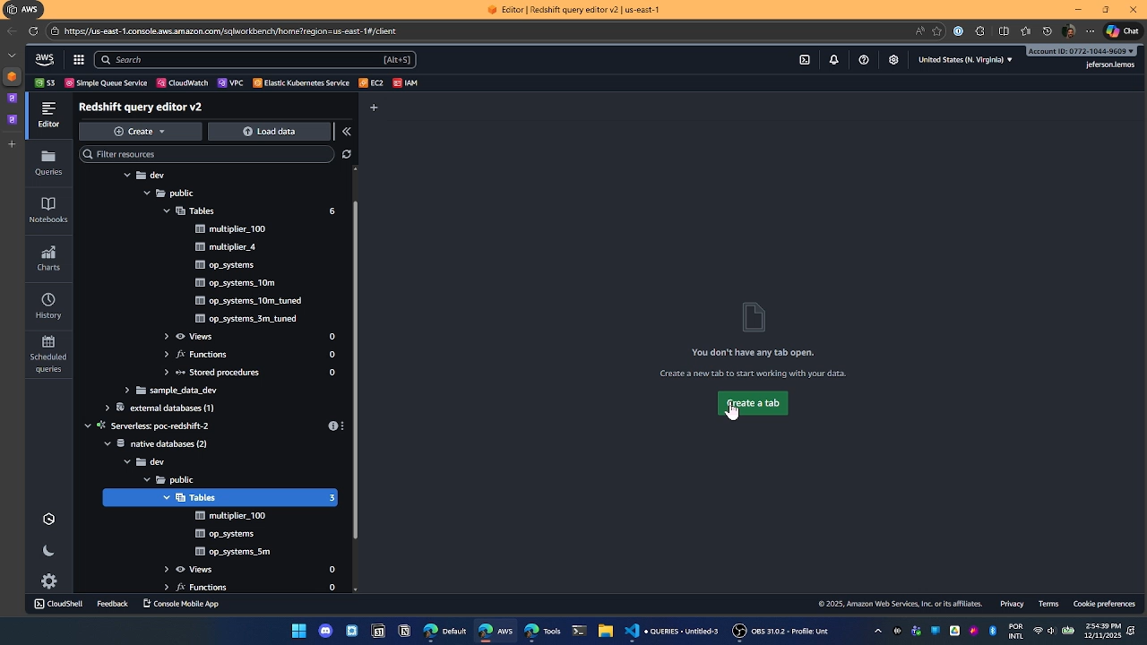
Live Demo

Slide 10
Links
https://aws.amazon.com/blogs/big-data/amazon-redshift-serverless-adds-higher-base-capacity-of-up-to-1024-rpus/
https://docs.aws.amazon.com/redshift/latest/dg/c_intro_about_redshift.html
https://medium.com/@coffeeandtips.tech/n%C3%A3o-quebre-mais-seus-dashboards-entendendo-distkey-e-sortkey-na-pr%C3%A1tica-f607aea20913
https://stackoverflow.com/questions/52885257/redshift-distkey-sortkey
https://www.bytebase.com/blog/snowflake-vs-redshift/
https://www.reddit.com/r/dataengineering/comments/y8ls9d/isnt_snowflake_exactly_the_same_as_redshift/
https://stackoverflow.com/questions/45021545/aws-redshift-vs-snowflake-use-cases
https://www.reddit.com/r/dataengineering/comments/jqh327/columnar_vs_row_based_db_query/
https://www.tigerdata.com/learn/columnar-databases-vs-row-oriented-databases-which-to-choose
https://docs.aws.amazon.com/redshift/latest/dg/c_challenges_achieving_high_performance_queries.html
https://www.youtube.com/watch?v=XNrsRVMfj1c&list=TLPQMTExMjIwMjUOjPdRA4ZcmA&index=4
https://www.youtube.com/watch?v=1MnvuNg33pA&list=TLPQMTExMjIwMjUOjPdRA4ZcmA&index=6
https://docs.aws.amazon.com/redshift/latest/mgmt/serverless-workload-management.html
Data warehouse system architecture - Amazon Redshift
AWS24003_Self Serve POC Redshift_final.pdf

